Slide 1

SNOWFLAKE HOL
Snowflake Intelligence
October 2025

Slide 2
Safe Harbor and Disclaimers
Other than statements of historical fact, all information contained in these materials and any accompanying oral commentary (collectively, the “Materials”), including statements regarding (i) Snowflake’s business strategy, plans or priorities, (ii) Snowflake’s new or enhanced products, services, and technology offerings, including those that are under development or not generally available, (iii) market growth, trends, and competitive considerations, (iv) our vision for Snowpark, the Data Cloud, and industry-specific Data Clouds, including the expected benefits and network effects of the Data Cloud; and (v) the integration, interoperability, and availability of Snowflake’s products, services, or technology offerings with or on third-party platforms or products, are forward-looking statements. These forward-looking statements are subject to a number of risks, uncertainties and assumptions, including those described under the heading “Risk Factors” and elsewhere in the Annual Reports on Form 10-K and the Quarterly Reports on Form 10-Q that Snowflake files with the Securities and Exchange Commission. In light of these risks, uncertainties, and assumptions, the future events and trends discussed in the Materials may not occur, and actual results could differ materially and adversely from those anticipated or implied in the forward-looking statements. As a result, you should not rely on any forwarding-looking statements as predictions of future events. Forward-looking statements speak only as of the date the statements are first made and are based on information available to us at the time those statements are made and/or management's good faith belief as of that time. Except as required by law, we undertake no obligation, and do not intend, to update the forward-looking statements in these Materials.
Any future product or roadmap information (collectively, the “Roadmap”) is intended to outline general product direction. The Roadmap is not a commitment, promise, or legal obligation for Snowflake to deliver any future products, features, or functionality; and is not intended to be, and shall not be deemed to be, incorporated into any contract. The actual timing of any product, feature, or functionality that is ultimately made available may be different from what is presented in the Roadmap. The Roadmap information should not be used when making a purchasing decision. In case of conflict between the information contained in the Materials and official Snowflake documentation, official Snowflake documentation should take precedence over these Materials. Further, note that Snowflake has made no determination as to whether separate fees will be charged for any future products, features, and/or functionality which may ultimately be made available. Snowflake may, in its own discretion, choose to charge separate fees for the delivery of any future products, features, and/or functionality which are ultimately made available.
The Materials may contain information provided by third-parties. Snowflake has not independently verified this information, and usage of this information does not mean or imply that Snowflake has adopted this information as its own or independently verified its accuracy.
© 2025 Snowflake Inc. All rights reserved. Snowflake, the Snowflake logo, and all other Snowflake product, feature and service names mentioned in the Materials are registered trademarks or trademarks of Snowflake Inc. in the United States and other countries. All other brand names or logos mentioned or used in the Materials are for identification purposes only and may be the trademarks of their respective holder(s). Snowflake may not be associated with, or be sponsored or endorsed by, any such holder(s).
Notes:
John:
Before we get started, I do want to share that we will be discussing some forward looking statements in today’s presentation.

Slide 3
Agenda
Introductions
Snowflake + Hakkoda
Demo
Hands-on Lab
How to Engage

Slide 4





Your Experts For Today
JOHN
DACOSTA
JACOB
SCOTT
ATALIA HORENSHTIEN
Senior Solution Engineer,
Snowflake
Senior Consultant, AI Engineering
Consulting Client Executive (Former Data Scientist)

Slide 5


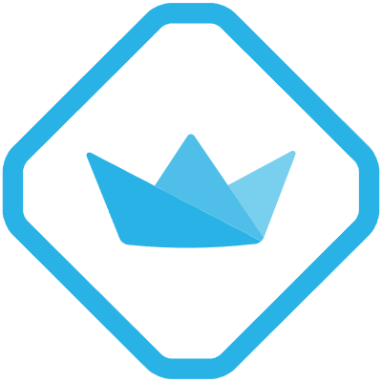

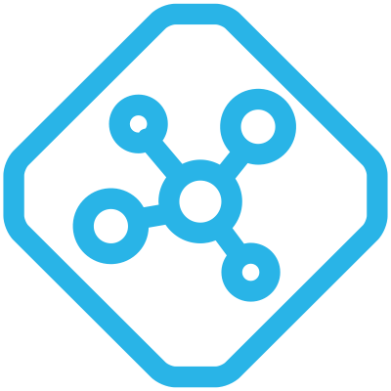



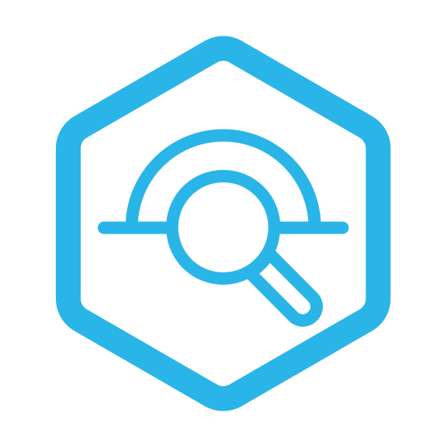
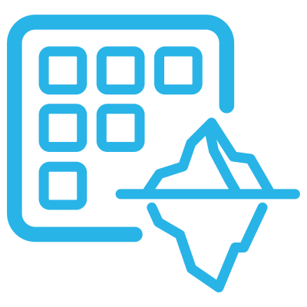
Snowflake Architecture
AI EXPERIENCES
Copilot
Document AI
Universal Search
DEVELOPER OPERATIONS
DEV EXPERIENCES
OPERATIONALIZATION
Notebook | Studio | Copilot | Worksheet | VS Code | APIs | Git Integration
Snowflake CLI | Database Change Management | Snowflake Trail | Serverless Tasks
DISCOVERY & DISTRIBUTION
Data | Apps | AI
INGESTION
TRANSFORMATION
ADVANCED ANALYTICS
MACHINE LEARNING
GENERATIVE AI
DATA PRODUCTS
STREAMING
Snowpark DataFrames
Dynamic Tables
Tasks, Serverless Tasks
Geospatial
Search Optimization
Time Series
Query Acceleration Service
SNOWFLAKE ML
SNOWFLAKE CORTEX AI
Streamlit
Secure Data Sharing
Snowflake Native App
Snowflake Data Clean Room
Snowpipe Streaming & Snowpipe
Kafka Connector
Snowpark ML API
Feature Store
Model Registry
ML Functions
Studio
Cortex Analyst
Cortex Search
Foundation Models
CONNECTORS
SaaS Connectors
Database Connectors
SNOWFLAKE ARCTIC
SNOWFLAKE HORIZON CATALOG
Compliance | Security | Privacy | Discovery | Collaboration
COMPUTE
RUNTIME
PROCESSOR
SQL | Python | Java | Scala | Snowpark Container Services
CPU | GPU
DATA
DATA TYPE
TABLE
Structured | Semi-Structured | Unstructured
Iceberg Table | Snowflake Table | Hybrid Table
CROSS-CLOUD SERVICES
Notes:
It's fantastic to see such a diverse group of data professionals here today. Whether you're a python enthusiast or expert, a SQL wizard, data scientist or ml engineer, Snowflake has you covered.
Today, we're going to demystify the Snowflake Architecture and show you how it's designed to empower everyone in the data lifecycle, regardless of your current experience with Snowflake.
I'm going to walk you through the capabilities from three different perspectives: the Data Engineer, the Data Analyst, and the Data Scientist/AI/ML Engineer, highlighting how Snowflake addresses your unique needs and challenges.
Before we dive into the specific personas, I want to highlight something that's crucial for all of us: our commitment to your development experience. We understand that engineers and analysts have diverse preferences when it comes to tools. That's why Snowflake offers a variety of ways to interact with the platform. You'll see the 'Dev Experiences' section prominently displayed. We offer a native Notebook experience directly within Snowflake for interactive development. But we also recognize that many of you prefer working in your local environments. So, whether you like to connect using VS Code, your favorite Jupyter Notebook, or through our robust APIs, Snowflake is designed to integrate seamlessly with your existing toolchain. This flexibility ensures you can build and innovate in the way that's most comfortable and productive for you.
So let’s start with the Data Engineer's perspective. For many of us, the journey begins with bringing data into the platform. I won't spend much time on this since the platform team provides the data as a service to the appropriate teams but you'll notice on the the left, under 'Ingestion,' Snowflake offers robust options for Streaming data in through Kafka or other real time mechanisms via our streaming API in addition to a wide array of connectors.
Once data is in, 'Transformation' is key. Here, Snowflake provides powerful tools like Dataframe Constructs, allowing you to use familiar programming constructs in Python, Java, Scala, and SQL for complex data transformations directly within Snowflake.
Now, let's shift gears to the Data Analyst. Once data is engineered and transformed, your focus is on extracting insights and delivering value. Look at the 'Discovery & Distribution' layer in the middle. Snowflake's Marketplace is a fantastic resource, allowing you to discover and access a wealth of third-party data, as well as share your own curated data securely . This drastically reduces the time spent on data acquisition and preparation.
Over on the right, under 'Data Products,' you'll see how you can operationalize your insights. Streamlit integration allows analysts to quickly build interactive web applications directly on top of their Snowflake data, making your findings easily consumable. Secure Data Sharing is fundamental to Snowflake, enabling you to share live data with internal and external stakeholders without data duplication.
Finally, for our Data Scientists and AI/ML Engineers, Snowflake is rapidly evolving into a robust platform for advanced analytics and machine learning. In the 'Advanced Analytics' section, capabilities like Geospatial functions and Search Optimization are critical for specialized data analysis.
Moving to 'Machine Learning,' Snowflake ML and Snowpark ML APIs bring your favorite ML libraries and frameworks directly to your data, eliminating the need to move data out of Snowflake for model training. You can build and manage a Feature Store, experiment with Model Registry, and deploy ML Functions for inference, all within the Snowflake ecosystem.
"Underpinning all of this is Snowflake's powerful 'Compute' layer, which is completely separate from 'Storage,' allowing for incredible scalability and performance. You can choose your preferred Runtime – SQL, Python, Java, Scala, and even Snowpark Container Services for more complex workloads. And the Processor can leverage both CPU and GPU for different computational needs.
At the very bottom, you'll see the fundamental 'Data' layer, supporting Structured, Semi-Structured, and Unstructured data, giving you the flexibility to handle any data type. And for tables, you have options from Iceberg Table to Snowflake Table and Hybrid Table.
Finally, all of this is powered by Cross-Cloud Services, giving you the flexibility to run Snowflake across different cloud providers, ensuring data residency and global reach.
In essence, Snowflake is designed as an integrated platform that supports the entire data and AI lifecycle, from ingestion and transformation to advanced analytics, machine learning, and generative AI. It's built for collaboration, performance, and ease of use, empowering data engineers to build robust pipelines, data analysts to derive quick insights, and data scientists to innovate with AI, all within a single, unified experience.

Slide 6







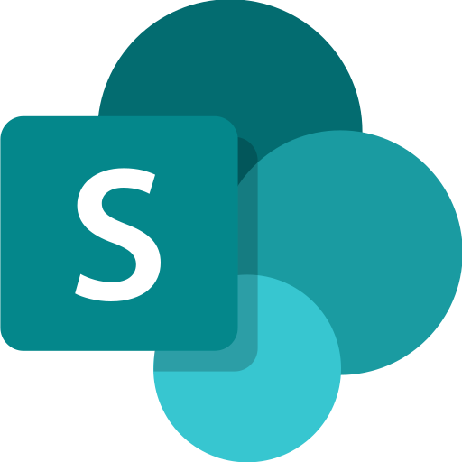



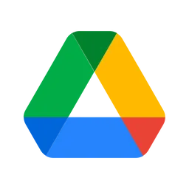
Snowflake Cortex AI is Easy, Connected, Trusted
Snowflake Cortex AI
AGENTS & INSIGHTS
MODELS
GOVERNANCE
Agent Apps Snowflake Intelligence ^{PU Soon}
Agent APIs Cortex Agents ^{GA Soon}
Multimodal AI-powered SQL
Cortex AISQL ^{PU}
RBAC
Guardrails
PROCESSING & RETRIEVAL
Unstructured Data Retrieval
Cortex Search
Structured Data Retrieval
Cortex Analyst
Structured Data Retrieval
Cortex Analyst
Document Processing
Document AI, Parse, Embed
Evaluations
Inference & Fine-Tuning APIs
Monitoring
DATA
Data Connectors
Openflow
AI Ready Data & Apps
Snowflake Marketplace
Multimodal Data
Snowflake, External
Embedding Models
AI Gateway
STR
DOC
AUDIO
IMAGE
GA: Generally Available | PU: Public Preview
Notes:
let's shift our focus to arguably the most transformative technology of our time: Artificial Intelligence. At Snowflake, we believe that AI should be Easy, Connected, and Trusted, and that's precisely what we've built with Snowflake Cortex AI.
Many organizations struggle with integrating AI into their workflows – it's often complex, requires specialized skills, and involves moving data around, which raises security and governance concerns. Snowflake Cortex AI is designed to address these challenges head-on, bringing the power of AI directly to your data within Snowflake, where it's already secure and governed.
Here are some talking points about the business value of Snowflake Cortex AI from this slide:
Easy, Connected, and Trusted AI: Snowflake Cortex AI simplifies AI integration into workflows, making it easy to use, connected to your data, and built on a foundation of trust.
Addressing AI Challenges: It tackles common organizational struggles with AI, such as complexity, specialized skill requirements, and data movement concerns that raise security and governance issues.
AI Directly to Your Data: The platform brings the power of AI directly to your data within Snowflake, where it is already secure and governed, eliminating the need to move data.

Slide 7
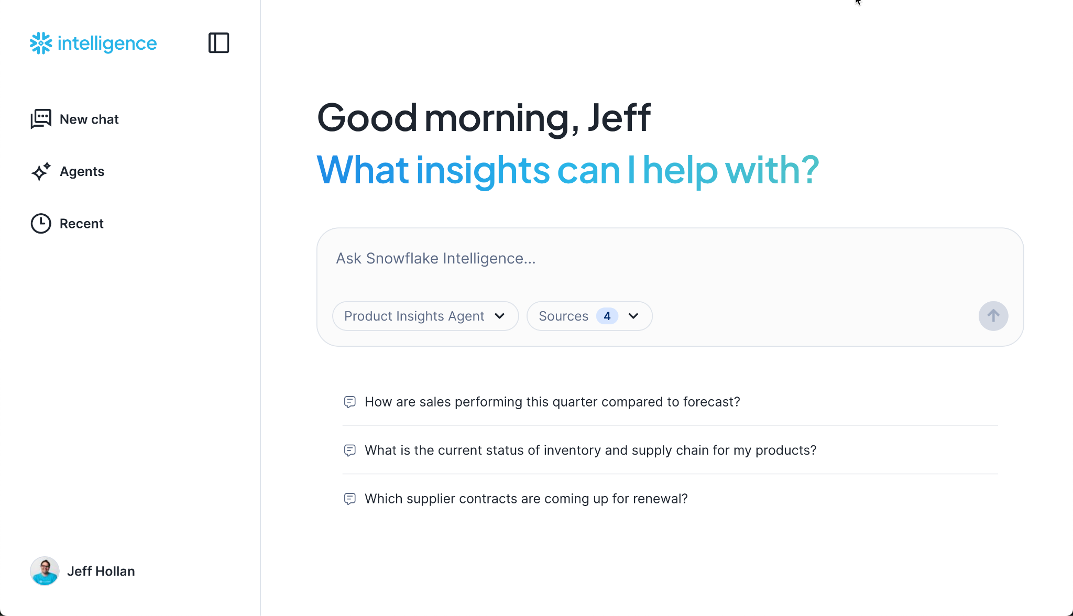
Introducing Snowflake Intelligence
AI-powered data agents for everyone
Ready-to-run application for rich conversational AI experiences on top of your Snowflake and business application data.
Integrated with Snowflake governance and access controls.
A standalone application so you can invite anyone in the business to surface insights and take action from your data.
ai.snowflake.com
Notes:
John:
Introduce Snowflake Intelligence and the basics of what it is:
Prebuilt UI
Integrated RBAC and Auth
Access to SQL tools

Slide 8
What Is An Agent?
AI agents dynamically handle multi-step actions and complex reasoning, a significant improvement over the mostly reactive software tools available today.
AI Agents refers to artificial intelligence systems that can be configured to reason through a task by breaking it into smaller subtasks for accomplishing a specific goal.
Planning
Track details
Tool use
Reflection
Think of it this way: - You talk to a chatbot, but - You delegate to an agent.
Notes:
Rough overview of what agents are for those who are uninitiated
So far we have seen tons of demos of chatbots; which are able to read business data and respond.
Key differentiator between where we are and where we are going is that An AI chatbot is designed to have a conversation, while an AI agent is designed to take action and complete tasks.¹
What is an AI Agent?
An AI Agent is an autonomous program that acts on your behalf to achieve a specific goal.
It perceives its environment, makes decisions, and takes actions independently.
How It Works:
Goal: You give it a high-level task, like "plan a trip to Hawaii."
Plan: It breaks the goal into smaller steps (find flights, book hotel, create itinerary).
Act: It uses tools and access to information to execute those steps automatically.
Key Characteristics:
Autonomous: Works on its own without constant supervision.
Goal-Oriented: Focused on completing the objective you give it.
Adaptive: Learns and reacts to new information or changes.
Real-World Examples:
Customer service chatbots
Personal travel assistants
Recommendation engines (Netflix, Amazon)
Self-driving cars
AI Chatbot
A chatbot's primary role is communication.² It's a conversational partner.³
Function: It reacts to your questions and commands within a conversation.
Scope: Its abilities are typically confined to providing information or performing simple, predefined tasks.
Example: Asking a website's support bot for your order status.
AI Agent
An agent's primary role is execution.⁴ It's an autonomous doer.⁵
Function: It proactively takes a goal, breaks it down into steps, and executes them without constant human input.⁶
Scope: It can interact with multiple apps, websites, and tools to complete complex, multi-step objectives.⁷
Example: Telling an agent to "book a flight to New York for next Tuesday morning under $300," and it does the searching and purchasing for you.⁸
Think of it this way: You talk to a chatbot, but you delegate to an agent.

Slide 9
How Snowflake Intelligence Works
Semantic View / Analyst
User Prompt
Agent Reasoning
Cortex Search
Tool Calls
Custom Tool
Pre-built tools (e.g. Chart Generator)
Generated Response
….
Large Language Model
Notes:
Discuss Tools it has access to and how user interacts
Here are five visionary use cases:
Travel & Hospitality: A Dynamic Guest Experience Agent that personalizes a traveler's entire journey, automatically rebooking logistics during a delay and suggesting activities based on their real-time onboard preferences. 🚢
Healthcare: A Hospital Operations Agent that autonomously optimizes staff schedules, manages patient bed allocation, and navigates the entire medical billing and insurance claims process to eliminate administrative overhead. 🏥
Multi-Location Retail & Food Service: A Distributed Operations Agent that manages inventory, adjusts local pricing, and launches hyper-targeted marketing campaigns for thousands of individual store locations simultaneously. 🍔
Finance & Banking: An Automated Corporate Treasury Agent that manages global cash flow, executes complex trading strategies, and neutralizes fraudulent transactions in real-time across all corporate accounts. 📈
Energy & Logistics: An Autonomous Supply Chain Agent that optimizes global logistics, executes real-time fuel and materials purchasing, and automatically re-routes entire fleets to avoid disruptions. 🚚

Slide 10
CONNECTING TO YOUR DATA

Slide 11
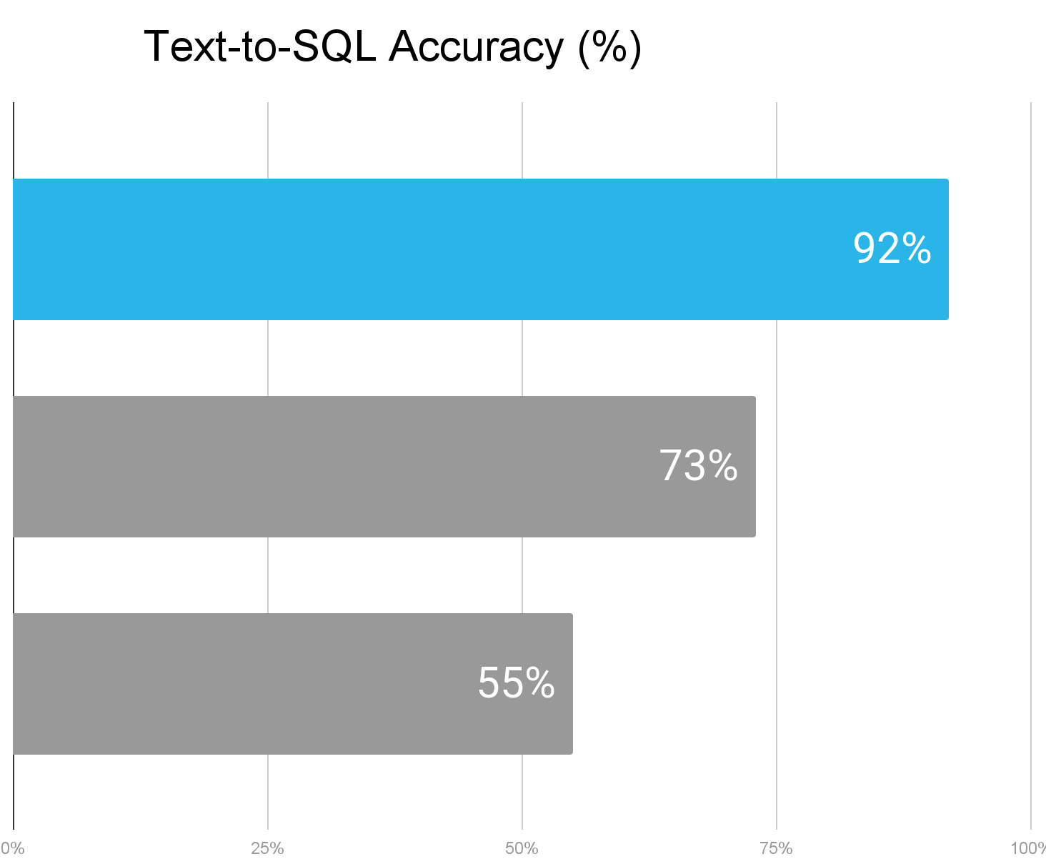

Surface Structured Insights Through Cortex Analyst
Why? Cortex Analyst is an agentic AI service powered LLMs on customer defined table semantics; all running inside Snowflake.
Customizable to your data
Enrich semantic model with business synonyms and metric definitions
Add common queries to Verified Query Repository (VQR)
Add business specific rules with custom instructions
OUT-OF-BOX ACCURACY
Cortex Analyst
Databricks
GPT-4o
*SQL generation accuracy on joins, based on internal benchmarks.
Source: Snowflake Cortex Analyst: Introducing Joins for Star and Snowflake Schemas.

Slide 12
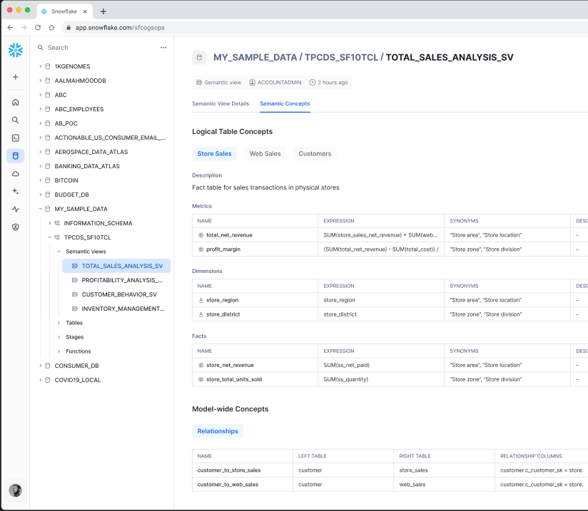
Snowflake Semantic Views
In Dev
Private
Public
GA
WHAT IS IT
Semantic View is a new schema level object that stores all semantic model information natively in the database, replacing the current Cortex Analyst YAML file stored in stage.
WHY USE IT
AI LLM accuracy is improved through the rule-based correctness of the Semantic Model. Allows BI business users to interact with data through consistent business metrics.
HOW TO USE IT
Users can access via any SQL interface or through the Cortex Analyst Semantic Model Generator.

Slide 13
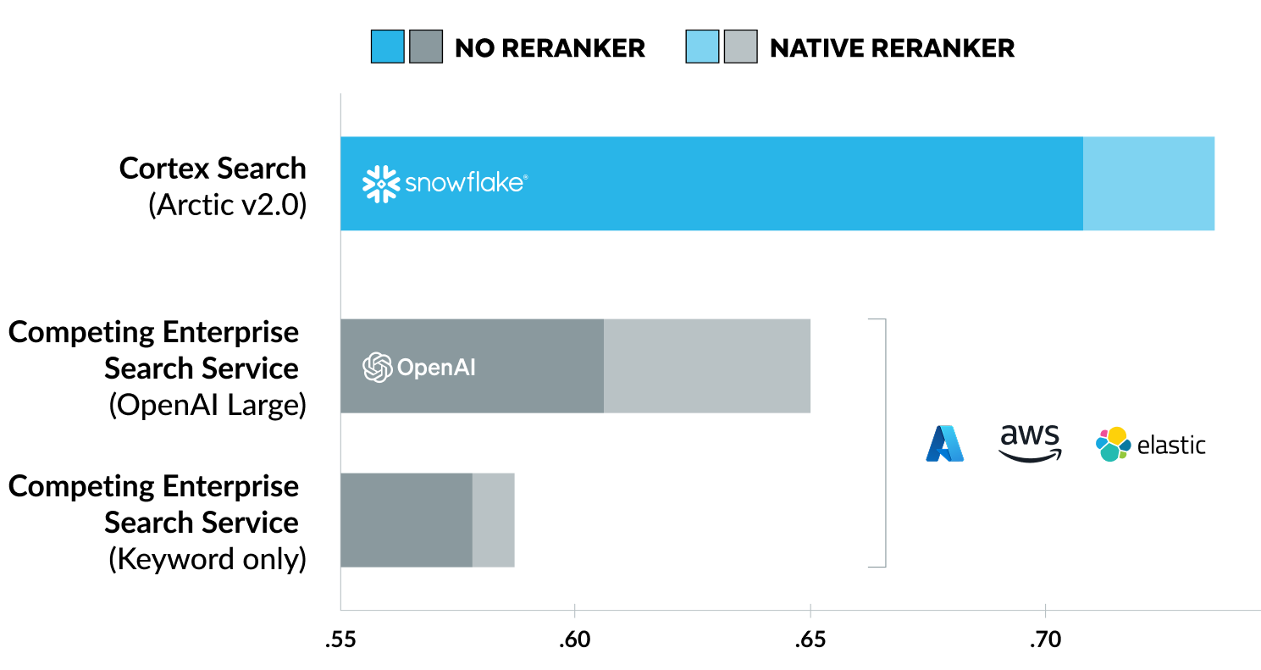
Surface Unstructured Insights Through Cortex Search
Why? Combines vector and keyword search methods, along with ensemble of reranking models and customizable scoring.
Customizable to your data
Automatically improve search quality via parameter tuning and evaluations
Personalize the search ranking based on business data and user signals
Semantic term boosting for adaptive business search requirements
OUT-OF-BOX ACCURACY
Retrieval system average performance across tasks
Avg NCDG@10
Source: https://www.snowflake.com/en/engineering-blog/cortex-search-unmatched-quality-simplicity/

Slide 14
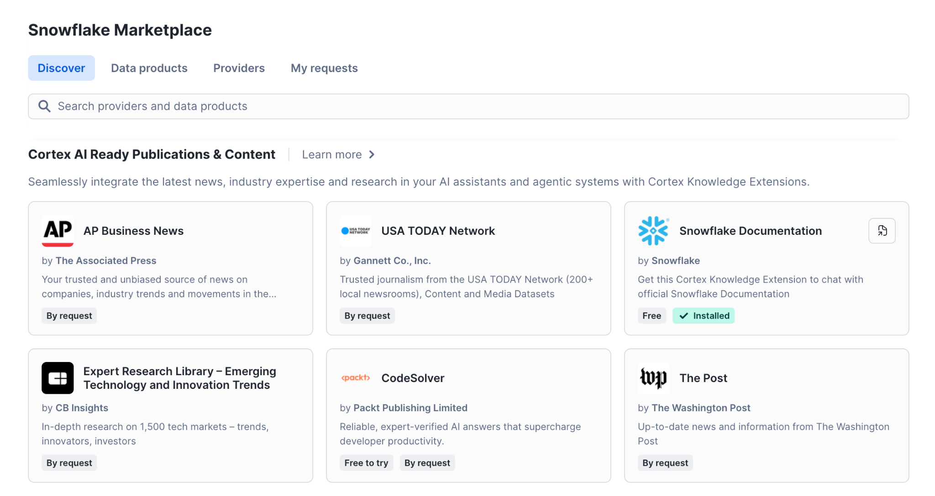
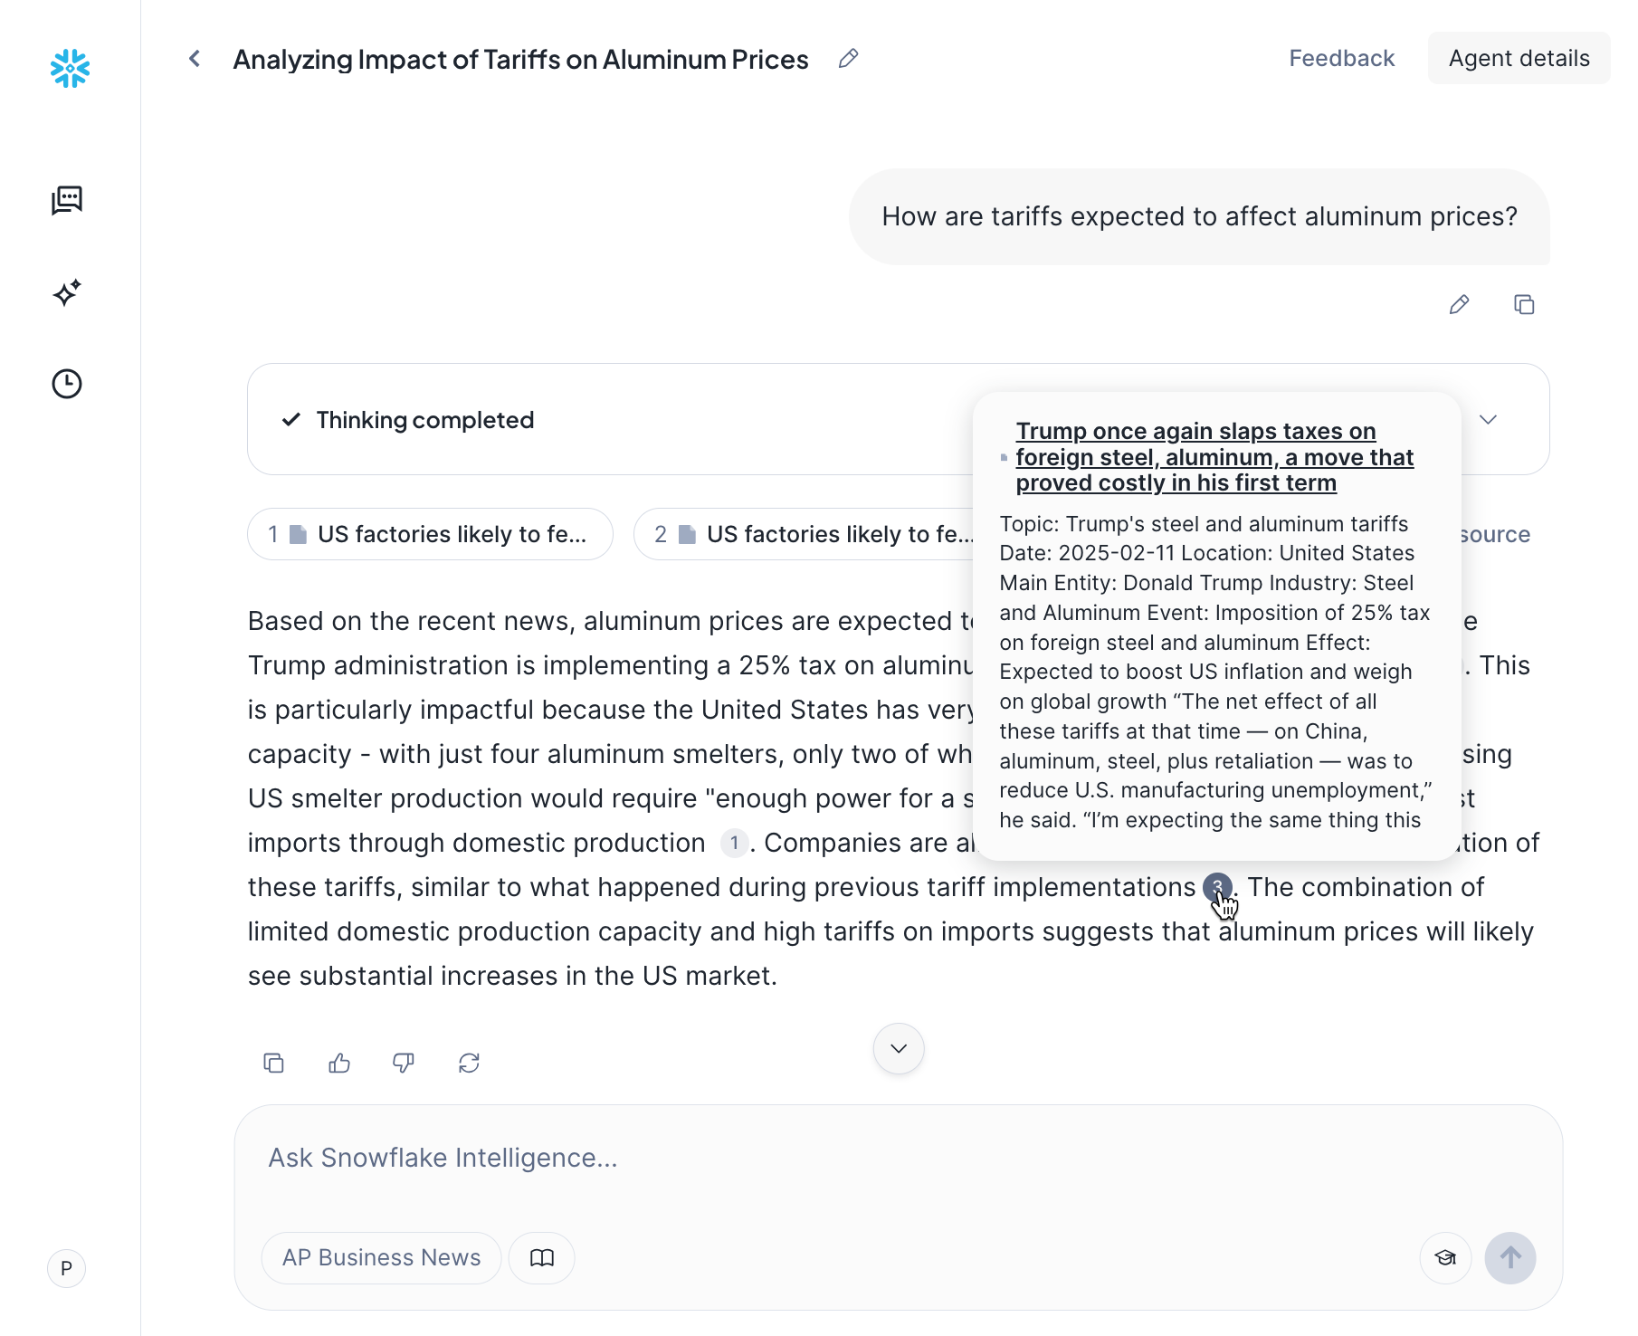
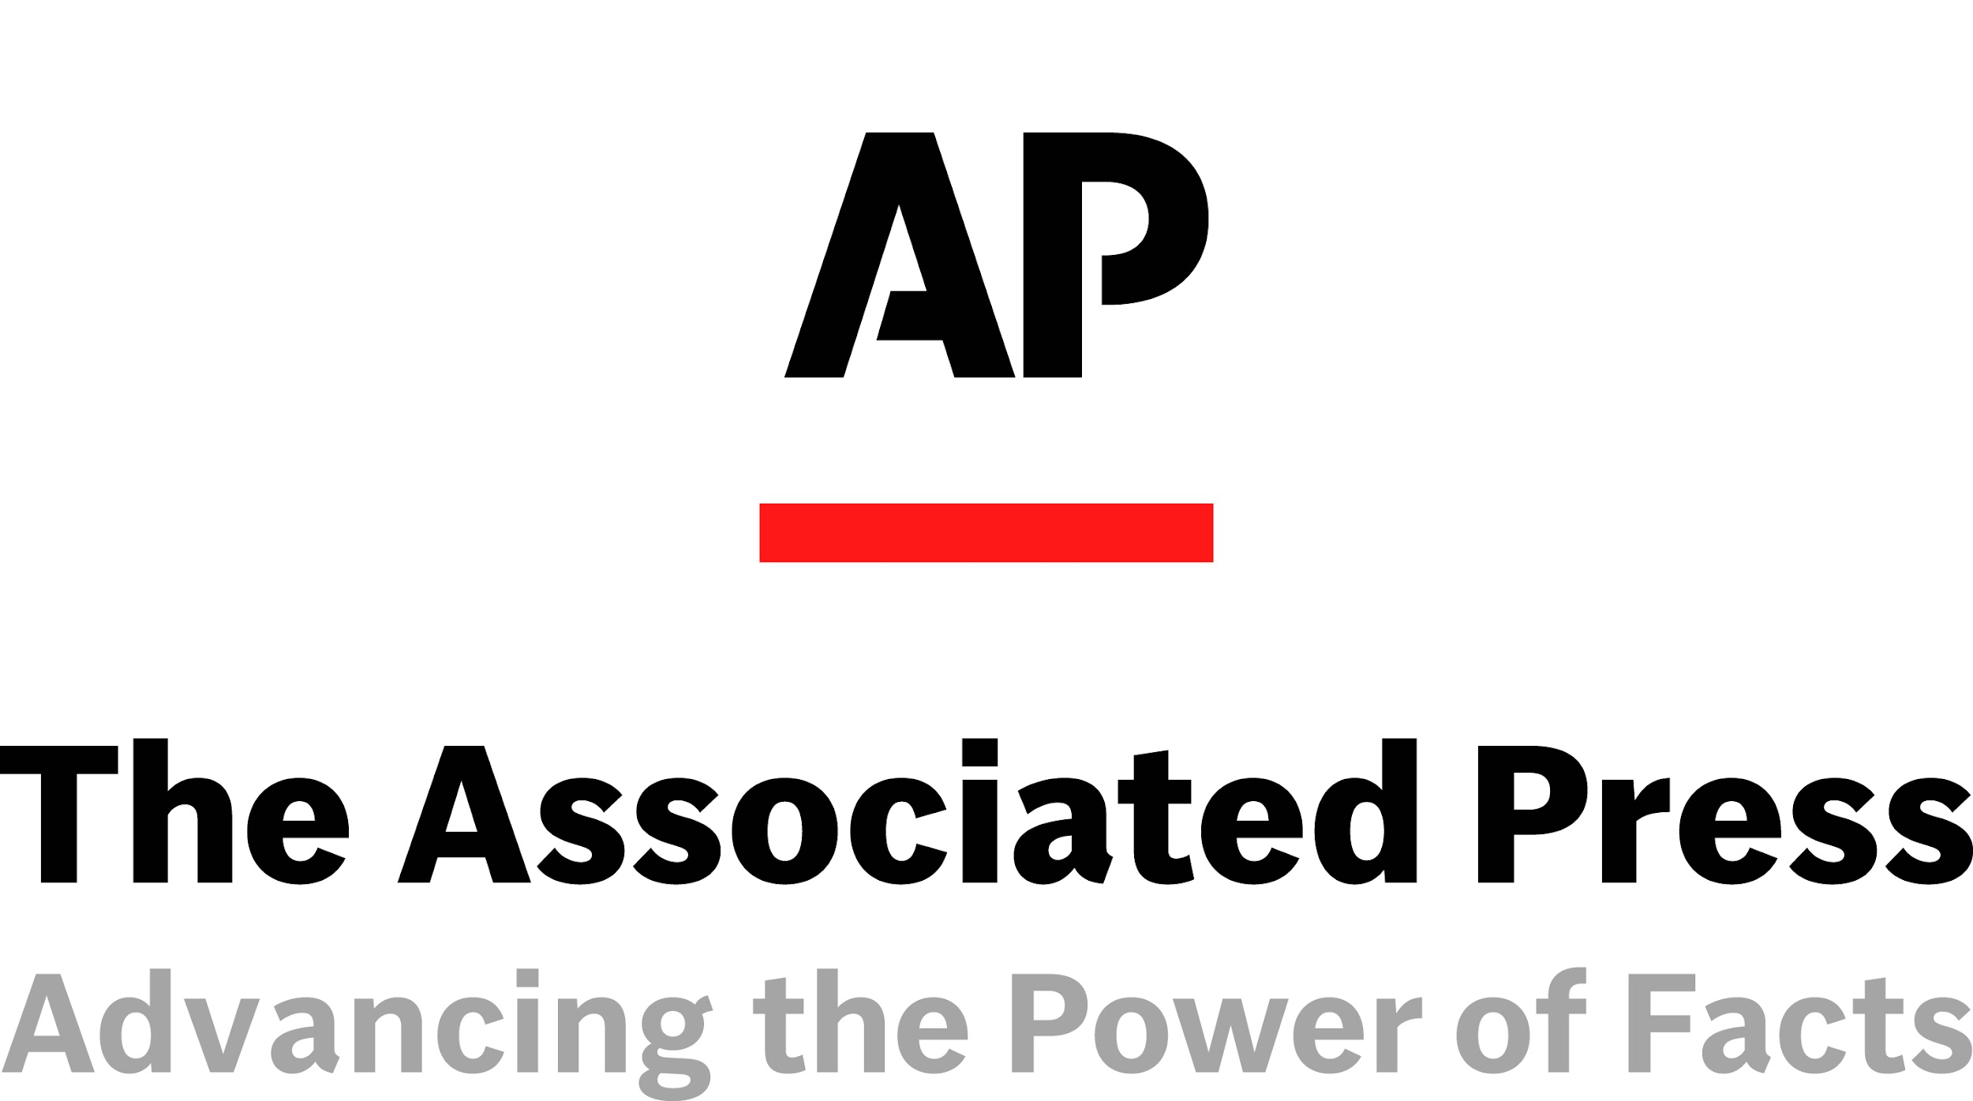











Enrich agents with external knowledge, effortlessly
Through AI-ready third-party data products
Avoid complex, unreliable scraping practices
Quickly access high-quality, AI-ready data sources from premium publishers
Easily enhance your AI context, without training
Connect up-to-date, clearly-cited data to your agents and enterprise AI with RAG
Built for enterprise security & compliance
Your prompts are confidential and data sources are properly licensed for AI
News & Expert opinions | Research papers | Technical books, documentation & forums | SaaS applications | Financial market data | Alternative data
Notes:
Snowflake simplifies how you use third-party data with your AI agents and enterprise AI. Instead of complex, manual scraping and data engineering efforts, you can quickly access high-quality, pre-processed data from leading data providers and content publishers.
Structured data is made AI-ready through the sharing of semantic views, allowing LLMs to draw useful insights from the data sets.
Unstructured data is delivered using Retrieval Augmented Generation (RAG), which provides direct insights and cites sources with hyperlinks, so users can easily verify answers. The providers handle all the backend work, including data cleaning, processing, and keeping it fresh. This means you get the insights you need without the engineering overhead.
Additionally, this solution offers a secure and trusted collaboration environment. All prompts are kept confidential, and data is provided with clear licensing to address compliance concerns.
Notes to sales:
For more on cortex knowledge extensions see here
To demo CKEs in Snowflake Intelligence from the Associated Press and others, please request a demo account here.
Hakkoda -
True Blue / Snowflake Only
Partner of the Year in Health Care LifeSciences
Value

Slide 15

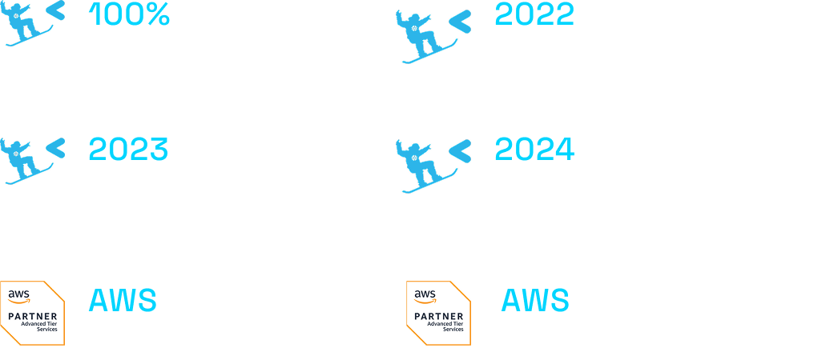
Snowflake & Hakkoda’s Partnership and the Impact on Our Customers
Technical Depth
Our team knows the Snowflake platform inside and out, and they use that knowledge to enable clients
Unique Capabilities
As an Elite partner, our engineers get exclusive access to the most innovative Snowflake features
Future-Proof Data Strategy
Our business is built on understanding where the marketplace is headed and helping our clients stay ahead of the curve.
Notes:
Hakkoda is one of our most strategic and technically advanced Elite partners.
They’re 100% SnowPro certified, so every engineer deeply understands the platform.
Over the years, they’ve earned multiple awards for excellence — most recently, Healthcare and Life Sciences Partner of the Year.
What makes them stand out is how they operationalize innovation — getting early access to features like Cortex and Native Apps and bringing them to customers first.
They don’t just implement Snowflake — they help our clients modernize today and design for the future, fully aligned with the snowflake’s vision.

Slide 16
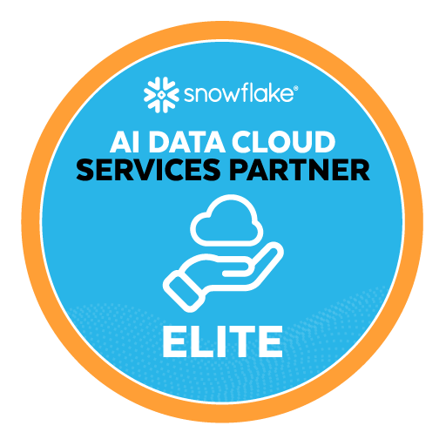
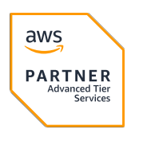
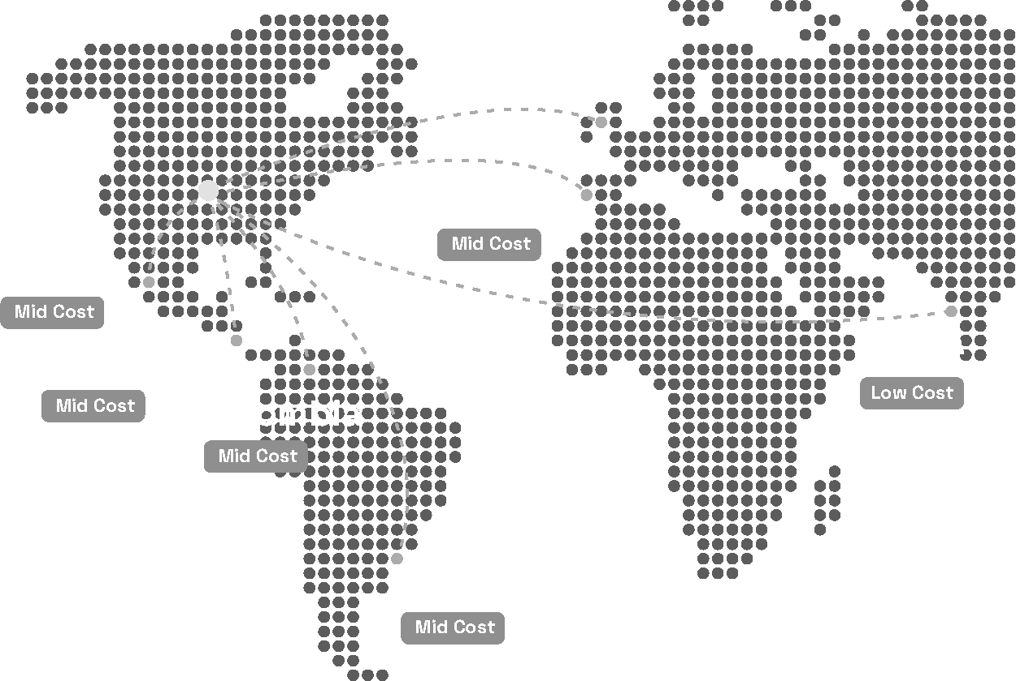
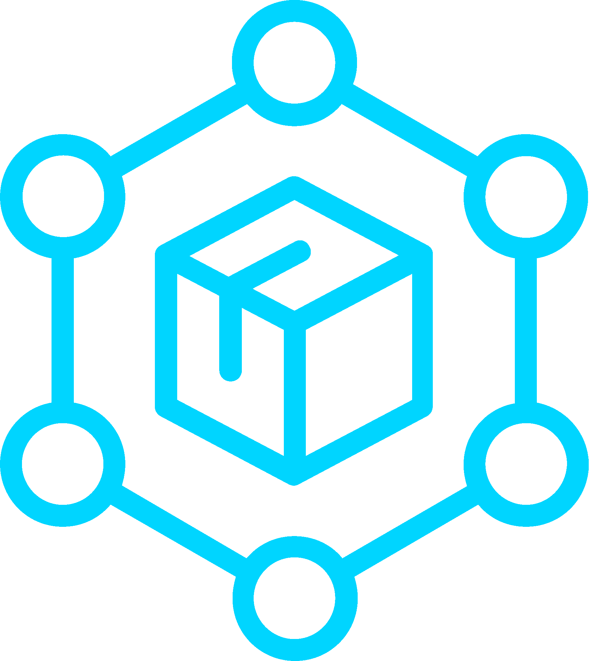


We’ve Been in Your Chair. Now, We’re in Your Corner.
Industry Experts
Global Teams
Modern data solutions aren’t built on technical expertise alone.
Our industry teams understand your business and come to the table with decades of experience driving practical results in complex and highly regulated industries.
Healthcare & Life Sciences
Financial Services & Insurance
USA
Public Sector (Fed & SLED)
Supply Chain & Logistics
Retail & CPG
Automotive
Notes:
Hakkoda is a modern data consultancy, built for the cloud era and for what’s next with data and AI.
We started in 2021 with a clear vision: to help organizations unlock the power of their data in the cloud, because that’s where the future was headed. And In 2025, we joined IBM
What makes us different is in our DNA. We blend industry experience, strategic enablement, and technical depth — helping clients move faster on their data and AI journey.
We have deep practices in healthcare and life sciences, financial services, retail, and CPG — led by people who actually come from those industries. We’ve been in your chair, we understand the challenges, and we bring a point of view.
On the technical side, we’ve built one of the strongest practices around the modern data and AI stack — focus on Snowflake, but also AWS, Coalesce, Atlan, Sigma, and more. And we know how to help you navigate the legacy systems you’re trying to move away from.
Out team is global by design, with onshore, near-shore, and offshore teams. For Florida specifically, our Costa Rica hub is a big advantage — Spanish language skills, cultural alignment, and time zone coverage that matter in practice.

Slide 17
Hakkōda’s Services
Data Strategy
Every successful journey begins with a plan, and a good plan is informed with experience and insight. Hakkoda wrapped our expertise and research into a framework called The Data Innovation Journey™ with the objective of guiding your organization along the path from Chaos to Innovation.
Migrate
Modernize
Monetize
We help your organization
move to cloud optimized technologies that deliver price
and performance.
Migrate from:
SAP BW / Hana
Teradata
Netezza
Exadata
MSSQL Server
Hakkoda’s Migration Accelerators
We help you adopt new
design patterns that enable the critical capabilities to compete in a AI driven world.
Modernize your:
Data Architecture
Governance & Security
Analytics
Data Operations
AI
Applications
We help you connect your
data investments to real
strategic outcomes.
Replatform or launch applications
Create new revenue streams
Reduce operating expenses
Make faster, data driven decisions
Managed Services
Our data and AI experts can not only get you there, we can keep you there. A cost effective, global team harnessing Hakkoda’s data ops copilots not only keep your systems running, we are constantly evolving them to keep you ahead of the competition.
Notes:
Once we know where you are in your journey, we can meet you there — and help move you forward.
Let me go a bit deeper on each stage of our services and what those actually mean in practice:
Migrate: Moving off legacy systems into cloud-optimized platforms that deliver better price and performance. We’ve helped clients migrate from SAP BW, Teradata, Netezza, Exadata, and SQL Server into Snowflake and modern stacks.
Modernize: Adopting design patterns that unlock new capabilities — rethinking architecture, strengthening governance, modernizing analytics, streamlining operations, and upgrading applications. This is how we get clients ready to compete in an AI-driven world.
Monetize: Turning data into measurable business value. That might mean creating new revenue streams through data products or sharing, or using AI and analytics to cut costs, improve customer experience, and build smarter offerings.
At every stage, our focus is simple: making sure data and AI investments translate into real business results.
we don’t just hand over a strategy and walk away. We execute in different models. With our product engineering teams and AI-driven accelerators, we help clients move faster, smarter, and more efficiently.
And if your team is stretched thin, we can take the weight off with managed services — keeping everything running, optimized, and ready to scale.

Slide 18

AI Innovation Consulting
Packaged Solutions
AI & ML Services
Gen AI Services
The Hakkōda AI Co-Innovation Center Storefront
Innovation Workshops (DIJ)
CINO as a Service
Value Engineering
Innovation Roadmaps
Change Strategy
Monetization Planning
Prototyping Sprintshops
AI Enabled Accelerators
Strategic GTM Accelerators
Monetization Solutions
AI Solutions
R&D as a Service
AI Development
AI Consulting
AI & ML Architecture / Design
MLOps Implementation
AI Application Development
AI Security & Governance
Gen AI Development
Gen AI Integration
Agentic Architectures
Prompt Engineers
AI Agent Development
Gen AI Basics Consulting
Adoption and Enablement
General Services
Data Innovation Journey | Advisory and Strategy | Delivery Management | Proactive Concierge
Notes:
And before I wrap up, I want to spend a minute on AI is the number one priority in almost every boardroom.
The truth is, the work we’ve been talking about — migration, modernization, monetization — is exactly what sets you up for AI success. Because without a solid data foundation, AI simply won’t deliver. As I like to say: good data in equals good BI, and only then, good AI.
Now, almost every company is planning to increase AI investment over the next few years. But very few would say they’re truly AI-mature. That’s the challenge: the ambition is there, but the readiness isn’t.
And this is where Hakkoda is different. About 18 months ago, we made a deliberate investment to create our AI Co-Innovation Center. We built it not only to innovate and serve our clients better, but also to embed AI into the way we work internally. It’s become both an engine for customer value and a proving ground for how we adopt AI ourselves.
We don’t just advise on AI — we build it. In the lab, our teams design copilots and agents that plug directly into core business operations.
We’ve built solutions for things like data cleaning and preprocessing, cataloging and discovery, governance and compliance, and automated data lineage.
And these aren’t proofs of concept — they’re live. They’ve helped us deliver faster, improve quality, and create measurable value for clients. In fact, our data migration copilot earned a CIO 100 award, which is a great validation of the impact we’re driving.

Slide 19
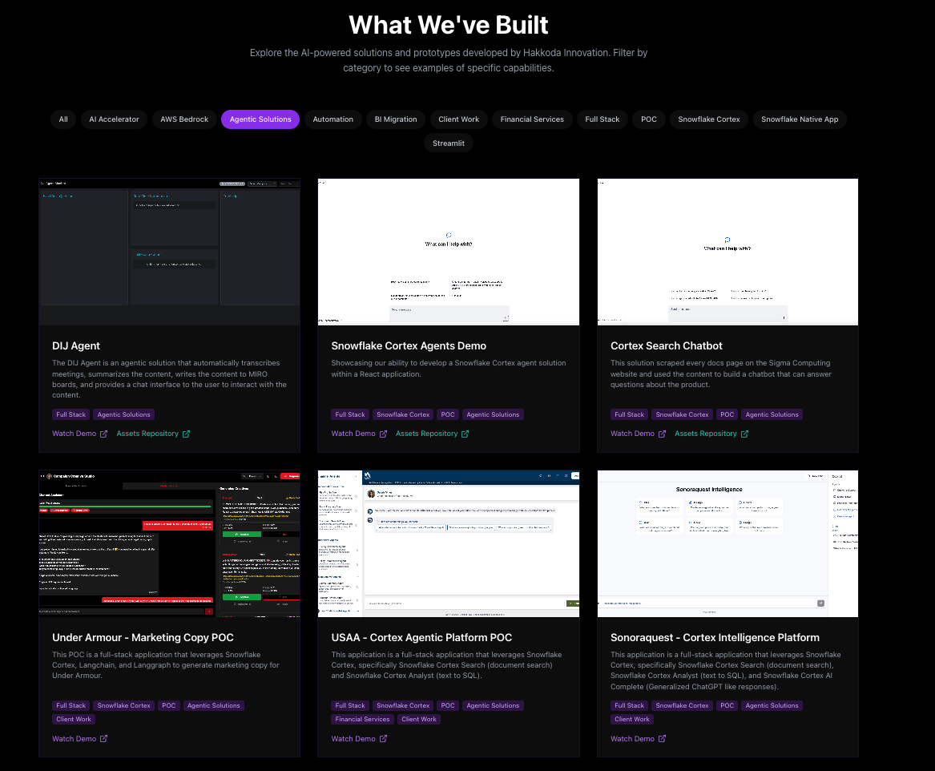
Notes:
https://hakkoda-innovation-dept.vercel.app/

Slide 20


Under Armour
Snowflake Intelligence Configuration
Automating Executive Intelligence for Under Armour’s Commercial Data
Challenge
The current process for responding to business questions remains highly manual and is not streamlined.
Cross-functional questions (e.g., "What's our AUR trend?" or "Why are we discounting?") require analysts to reconcile definitions, stitch multiple tables, and validate against Tableau logic.
Executives lack fast, consistent "why" explanations and must rely on analyst time and manual investigation.​
Solution
Focus: Define a focused POC using the Commercial/Omni model,
Metrics: Project anchored to well set of certified metrics.
Proving Value: Pilot first with analysts and prove accuracy and usefulness. Once trust is established, extend to executive leadership.a
Overview
Outcomes
The current process for responding to business questions remains highly manual and is not streamlined. UA is looking to scale their AI strategy and leverage some of the AI functionalities Snowflake Intelligence brings out-of-the-box to solve for this problem.​
Instant Answers– Solution allows leaders to get live and instant answers to their adhoc questions.
Trusted Results– Trusted solution provides answers that executives can trust on top of existing quality data.
Notes:
Using their existing data models we are providing AI insights using snowflake intelligence to answer executive questions on sellout data.
What we are doing:
Gathering requirements and documentation, transferring information into semantic models ( yamls )
Evaluation and iterative improvement of the model

Slide 21


Cortex Agent Development for Data Analysis
Building a Negotiation Assistant for Medtronic Global Supply Management
Challenge
Heavy burden on analytics and data team
Turn around on supply chain questions and negotiation information was much too slow to be effective.
GSM’s needed to know the why in addition to the what that currently existed in Tableau.
Solution
Supply Chain Focus: Define a focused POC using two main supply chain tables.
Defined Questions: Defining a preset area of questions allowed for focused development.
Overview
Outcomes
Medtronic’s Global Supply Chain Managers needed rapid access to business insights in order to effectively negotiate with vendors. Cortex Agents (underlying framework for SI) were utilized to build assistants.
Instant Answers– Solution allows GSM’s to get live and instant answers to their adhoc questions.
Trusted Results– Trusted solution provides answers that executives can trust on top of existing quality data.
Notes:
Using Cortex Agents to help supply chain managers negotiate commodity pricings:
Commodity and supply chain data
Unstructured data analysis
Development of cortex agents for use via REST API
Creation of agents, context (yamls), and their orchestration\

Slide 22
DEMO

Slide 23
HANDS ON LAB

Slide 24
PRACTICAL
GUIDANCE

Slide 25
Best Practices and Tips
Each agent should have a business owner and a data owner working collaboratively
Start small - find a single business function or application, build it, test it, improve it. Grow from there
The semantic model is often the best place to add more data and context to improve the quality of your agent
1
2
3
Bigger is not always better for your semantic view. Splitting views makes it easier for the agent to call across multiple datasets
Create golden dataset to ensure the experience does not regress as you add more functionality to your Agent
Conduct a pilot with a small set of users to identify interaction blind spots
4
5
6

Slide 26
Expanding Beyond the Pilot
Use Domain Specific Agents
Evaluation and Observability
Tune Prompting and Context
Sales
Supply Chain
Marketing
USE SAMPLE QUESTIONS
Show me correlation between guest feedback and ops issues.
Investigate inaccuracies to continuously improve semantic views and orchestration prompts
Analyze supply chain disruption for South Florida
Notes:
What are next steps
Based on your list of attendees, which includes companies in the cruise line (NCL, Norwegian Cruise Line), healthcare (Baptist Health, Chenmed), and retail/hospitality (PetSupermarket, Burger King, Hard Rock Bet, Restaurant Brands International) sectors, here are 5 sample questions that can provoke thought and demonstrate the value of Snowflake Intelligence. These questions leverage both Cortex Search (for unstructured data) and Cortex Analyst (for structured data) to provide a holistic, high-value response.
For NCL/Norwegian Cruise Line: "What is the correlation between unstructured guest feedback from post-cruise surveys and customer loyalty scores, and what are the top three operational issues, such as delays or service quality complaints, that led to a decline in repeat bookings for the last quarter?"
Why it works: This question combines Cortex Search to analyze the unstructured text in guest surveys and Cortex Analyst to query structured data like booking history and loyalty program metrics. It shows how they can move beyond simple sentiment analysis to identify specific, actionable problems.
For Baptist Health/Chenmed: "Based on patient electronic health records (EHRs) and unstructured doctor's notes, what is the prevalence of adverse drug reactions among patients with a history of hypertension, and how does this correlate with readmission rates?"
Why it works: This question highlights the ability to get insights from both structured patient data (EHRs) and unstructured data (physician notes), a common challenge in healthcare. It addresses high-impact use cases like patient safety and care quality.
For Burger King/Restaurant Brands International: "Analyze supply chain disruption reports and social media chatter from the last six months. How did a specific supply issue, such as a shortage of key ingredients, impact sales revenue for our most popular menu item in the South Florida region?"
Why it works: This is a powerful use case for Cortex Search (analyzing news articles, social media) and Cortex Analyst (analyzing sales data). It demonstrates how to connect external, unstructured events with internal, structured business outcomes, which is critical for mitigating risk and optimizing operations.
For PetSupermarket: "How can we identify and respond to customer service issues faster by using a unified view of structured support ticket data and unstructured customer chat transcripts to pinpoint recurring product complaints by region?"
Why it works: This question directly targets a core retail challenge: customer experience. It shows how to use Cortex Search on chat logs to find the "why" behind complaints and then use Cortex Analyst to quantify the impact and localize the problem.
For all companies: "What is the average time it takes for an employee to find a specific policy or procedure in our internal knowledge base, and which departments or locations are struggling the most? What are the top three documents and knowledge base articles that are most frequently searched for but rarely found?"
Why it works: This is a broad, high-TAM question applicable to any organization. It addresses internal productivity and operational efficiency. It uses Cortex Search to analyze search query logs (unstructured data) and Cortex Analyst to analyze employee metadata and search performance metrics (structured data). This shows a clear path to improving employee experience and reducing time-to-insight.

Slide 27
Roadmap
Ability to upload attachments and ask questions (.xslx, .csv, .docx, .pdf…) [Oct]
Snowflake Intelligence / Agents REST API [PuPr Now - Cortex Data Object Agent]
MCP integration (call agent via MCP [Sept], or add MCP as tools [~Dec])
Improvements to charts (look and feel, styles, customization) [Sep/Oct]
Semantic View automations – auto-improve based on verified queries, enrich semantic view with other datasets (Tableau, Power BI, dbt, …) [PrPr now, Oct PuPr]
Theming and brand customization (logo) [Sept]
Observability improvements – see conversations happening with an agent [Sept], and trace the agent reasoning / inputs for answering [Sept/Oct], eval sets [~Oct PrPr]
Usage and Spend Views [Oct]
Ability to do analytics over a large set of search documents [Oct]
GA [Early November]
Save charts or chat outputs [~Nov/Dec]
Schedule a chart or artifact to get updates [~Nov/Dec]

Slide 28
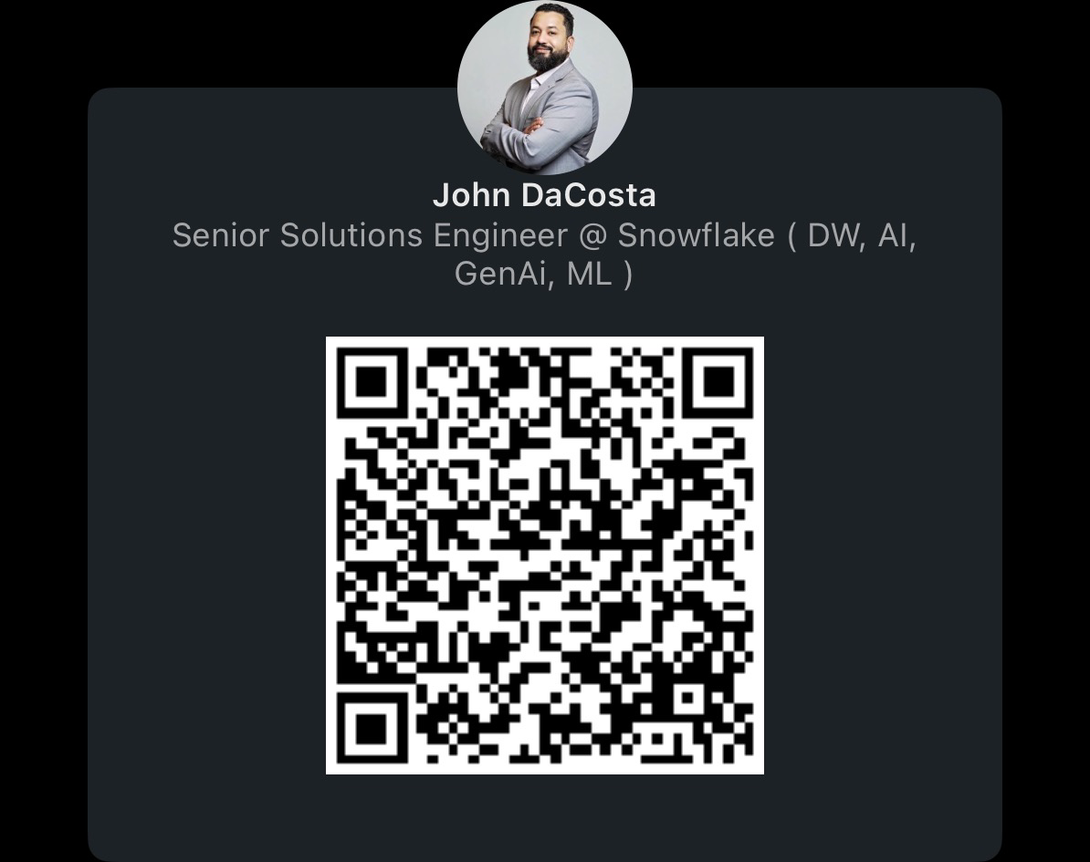
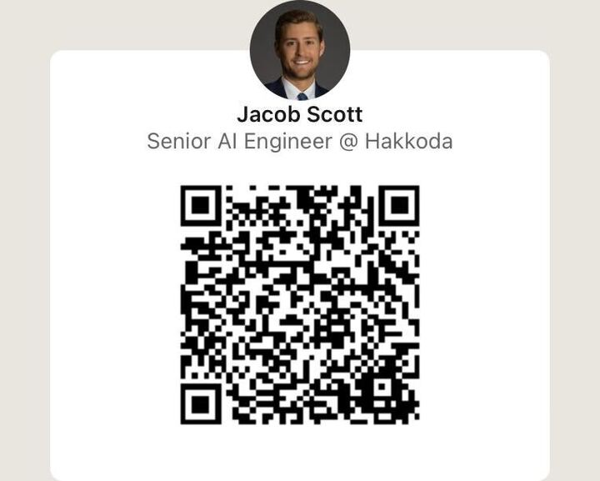
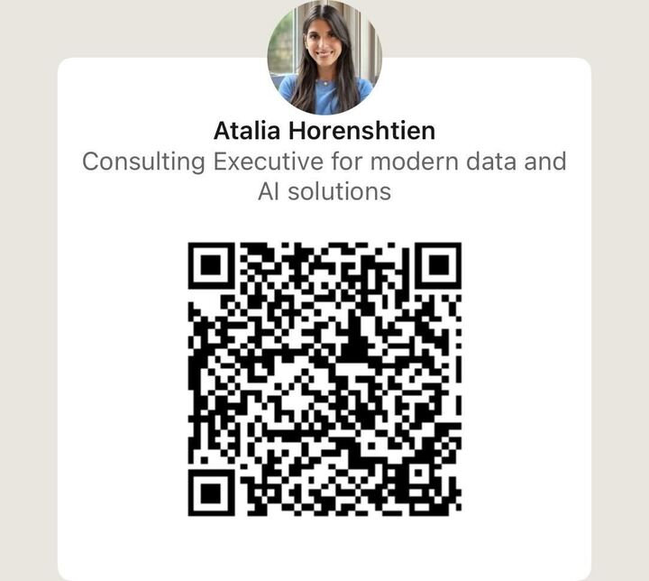
Stay Connected
JOHN
DACOSTA
JACOB
SCOTT
ATALIA HORENSHTIEN
john.dacosta@snowflake.com
jacob.scott@ibm.com
atalia.horenshtien@ibm.com
Notes:
Pause here for 1-3 minutes so people can screenshot contact info
Add qr codes for contact on LinkedIn
Memory Trick → Tell to screenshot the profile after adding to recall place and time

Slide 29
Next Steps
Book a Meeting / Working Session

Slide 30
THANK YOU

Slide 31
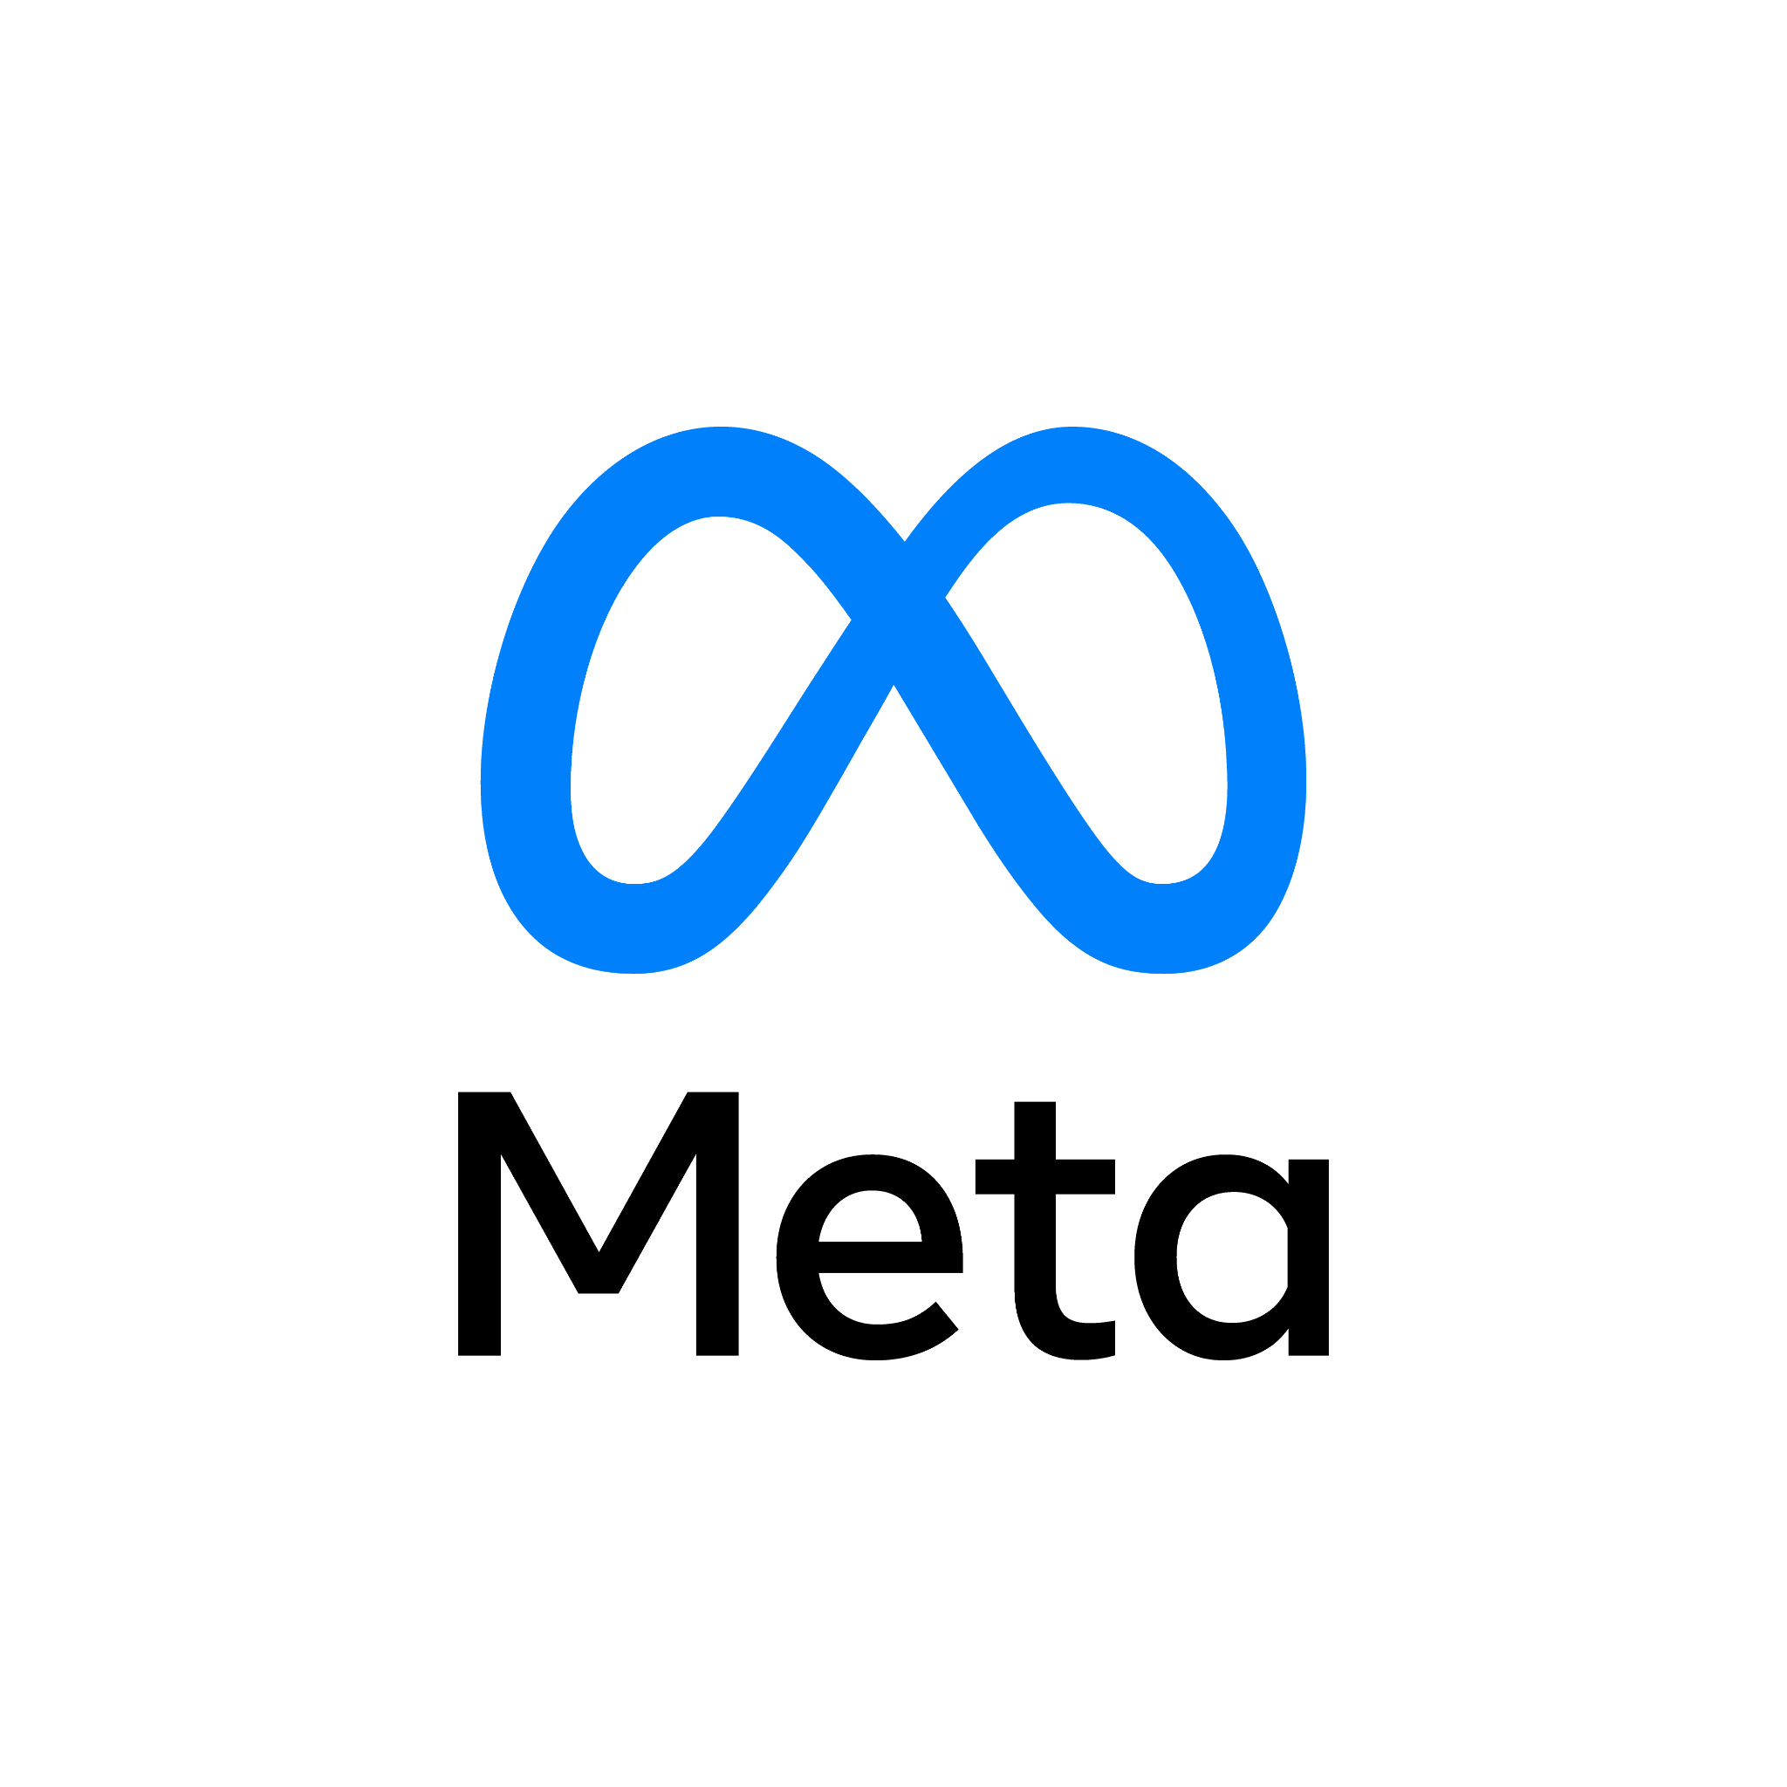





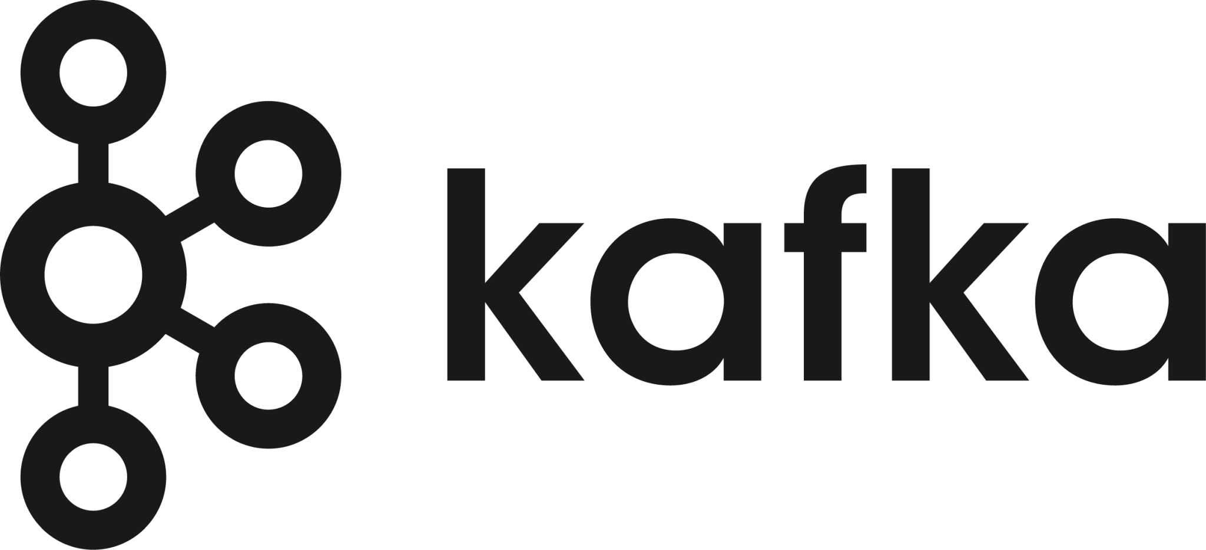



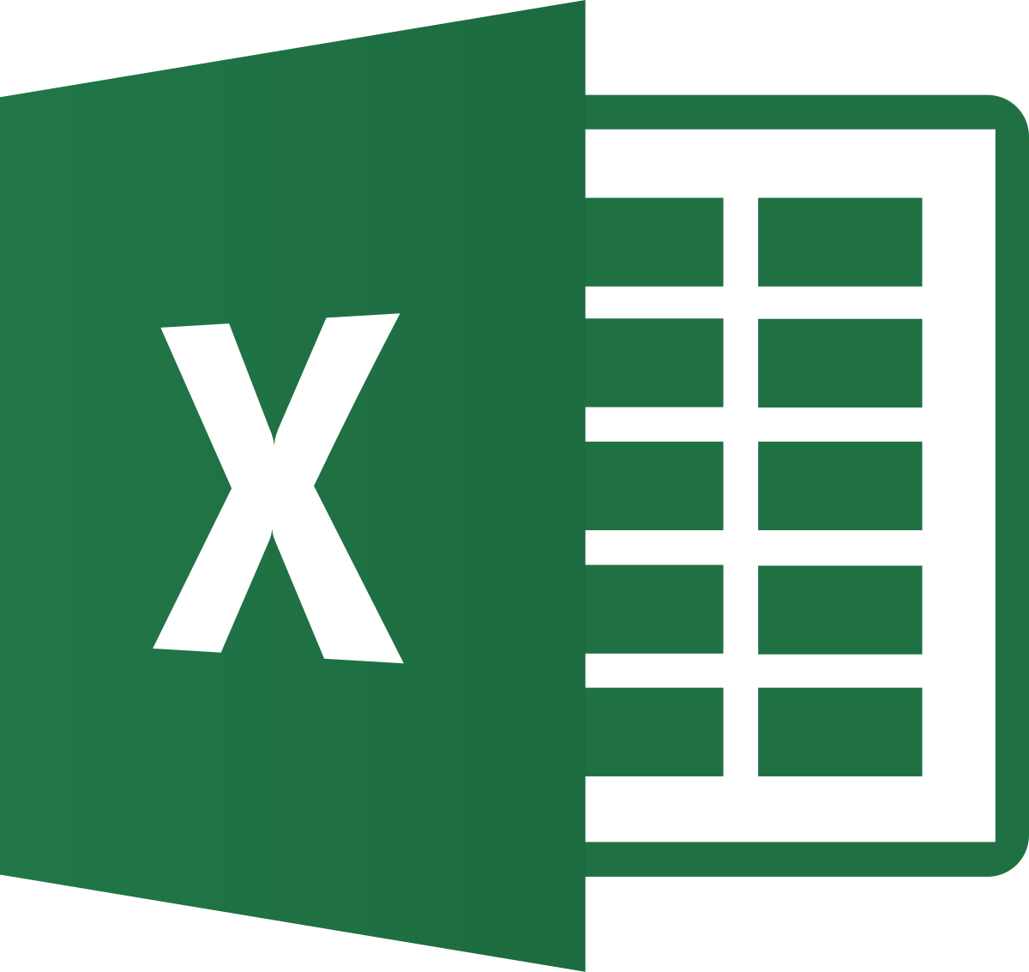


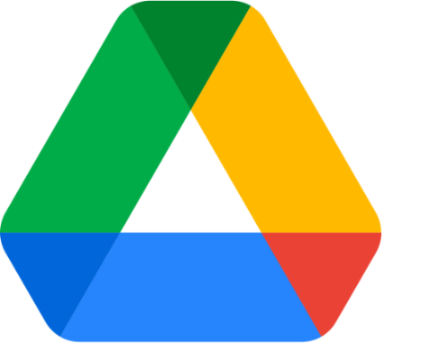
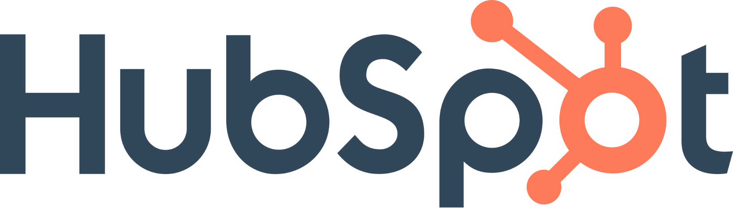




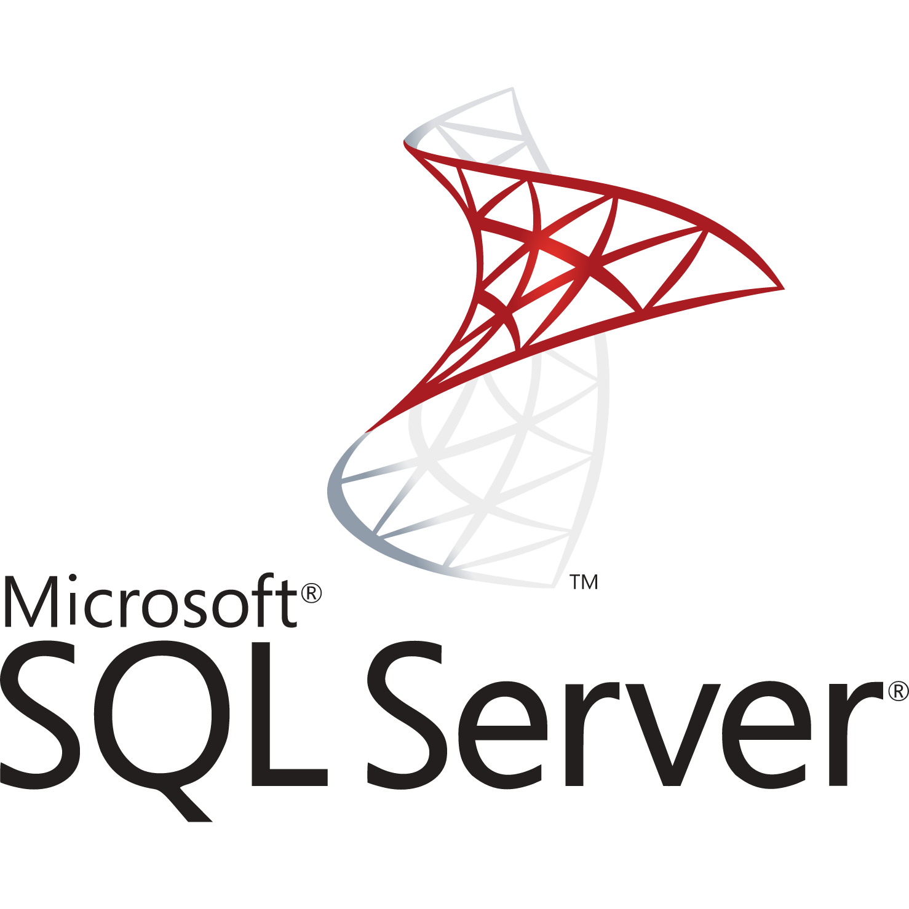
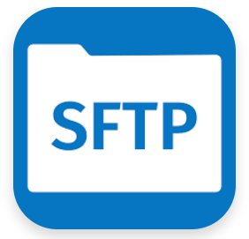


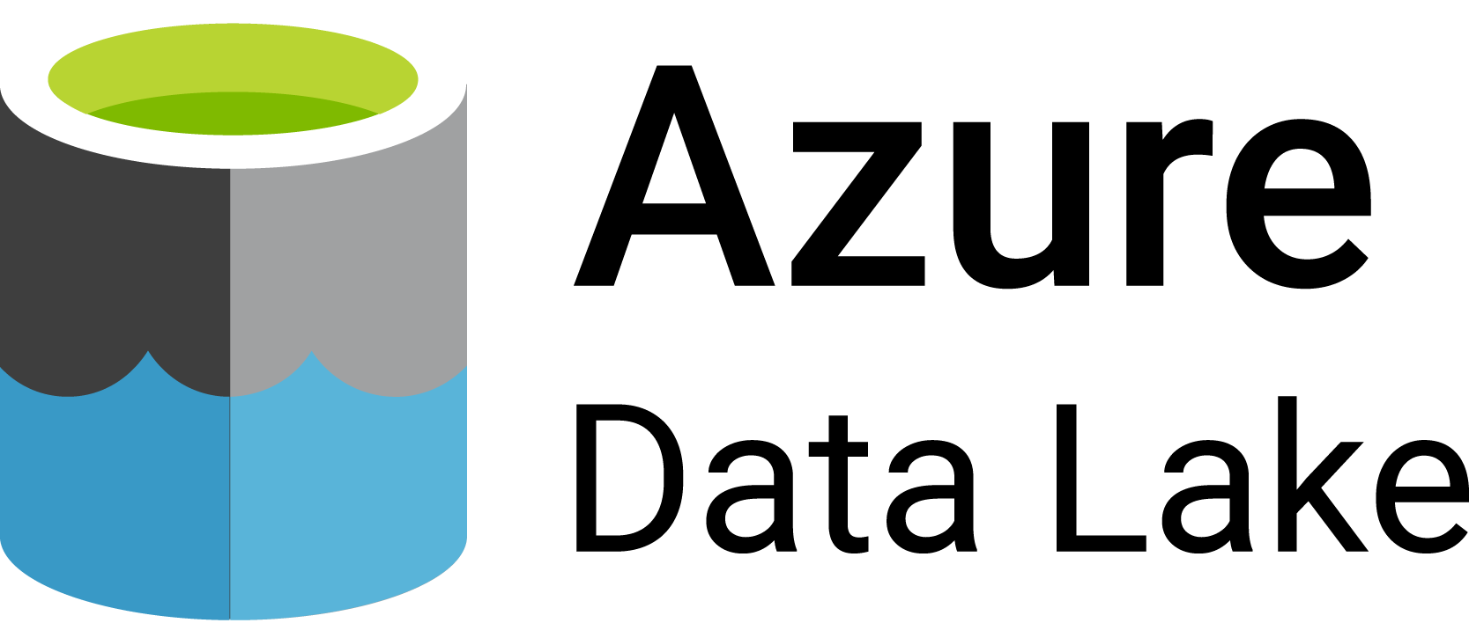
Openflow Connectors in GA and PuPr as of June 3rd, 2025
SaaS
Meta Ads
Microsoft Dataverse
Google Sheets
Streaming
Unstructured
Database
Others
Azure Blob Storage
Azure Data Lake Storage

